Slide 1



Pizza Drones

Slide 2

PIZZA DRONE = $$ MONEY $$

Slide 3
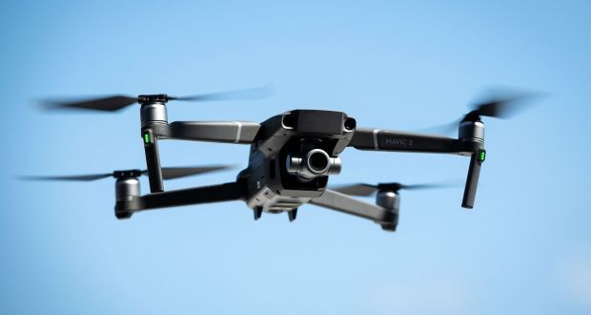
Value Chain: Pizza Drone
Support Activities
Firm Infrastructure | Funds Collection to start the business | Administrative Tasks: taxes, bank/book keeping
Human Resources | Manage/Training Employees | Appraisals and rewards | Freedom of thought | Conducting Meetings
Technology Development | Feedback from Customers | Research work w/ Drones | Improving the product and innovation | Use of IT, Databases, Drone advancements
Procurement | Acquiring the resources | Ingredients from local suppliers
Primary Activities
Inbound Logistics: Purchase Raw Materials: Dough, cheese, sauce, fruits/veggies, salt/pepper | Operations: Preparation of pizza base, Customization of pizza, on time drone pizza delivery | Outbound Logistics: Transporting pizza bases, Serving pizza hot via-drone-oven | Marketing and Sales: Segmentation Target Market, Branding, Redefining our Menu, Intro new products, Pricing, Distribution, Advertising, Promotional Offers | Service and Support: Customer feeds comfortable, Online Orders, Home Drone Delivery

Slide 4
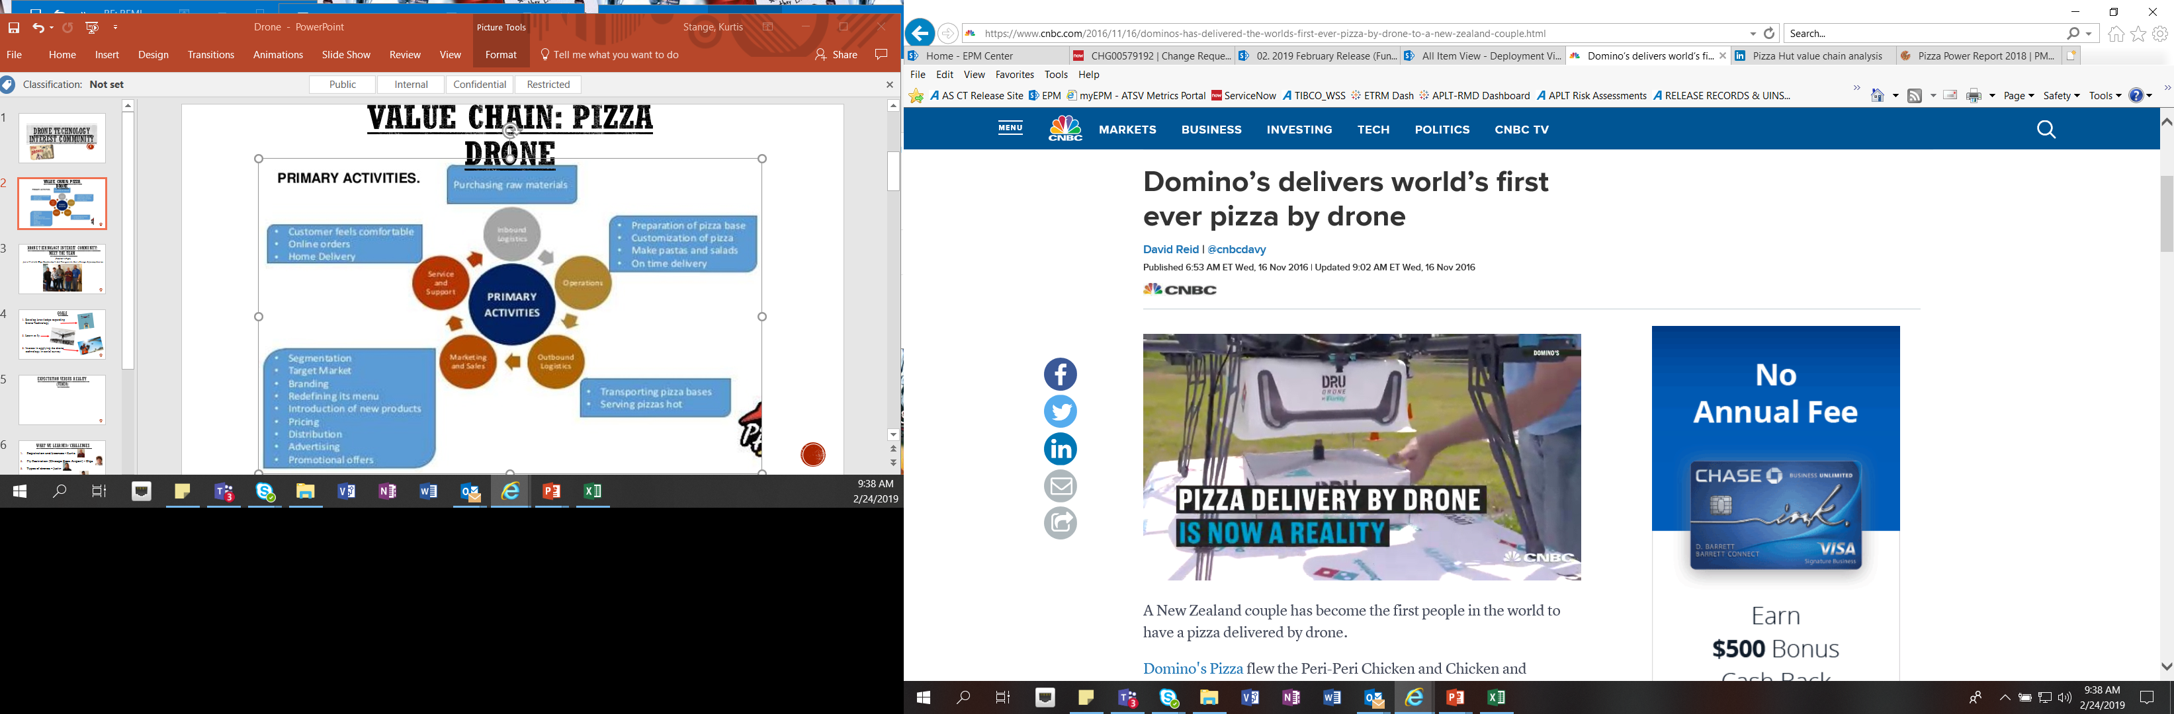
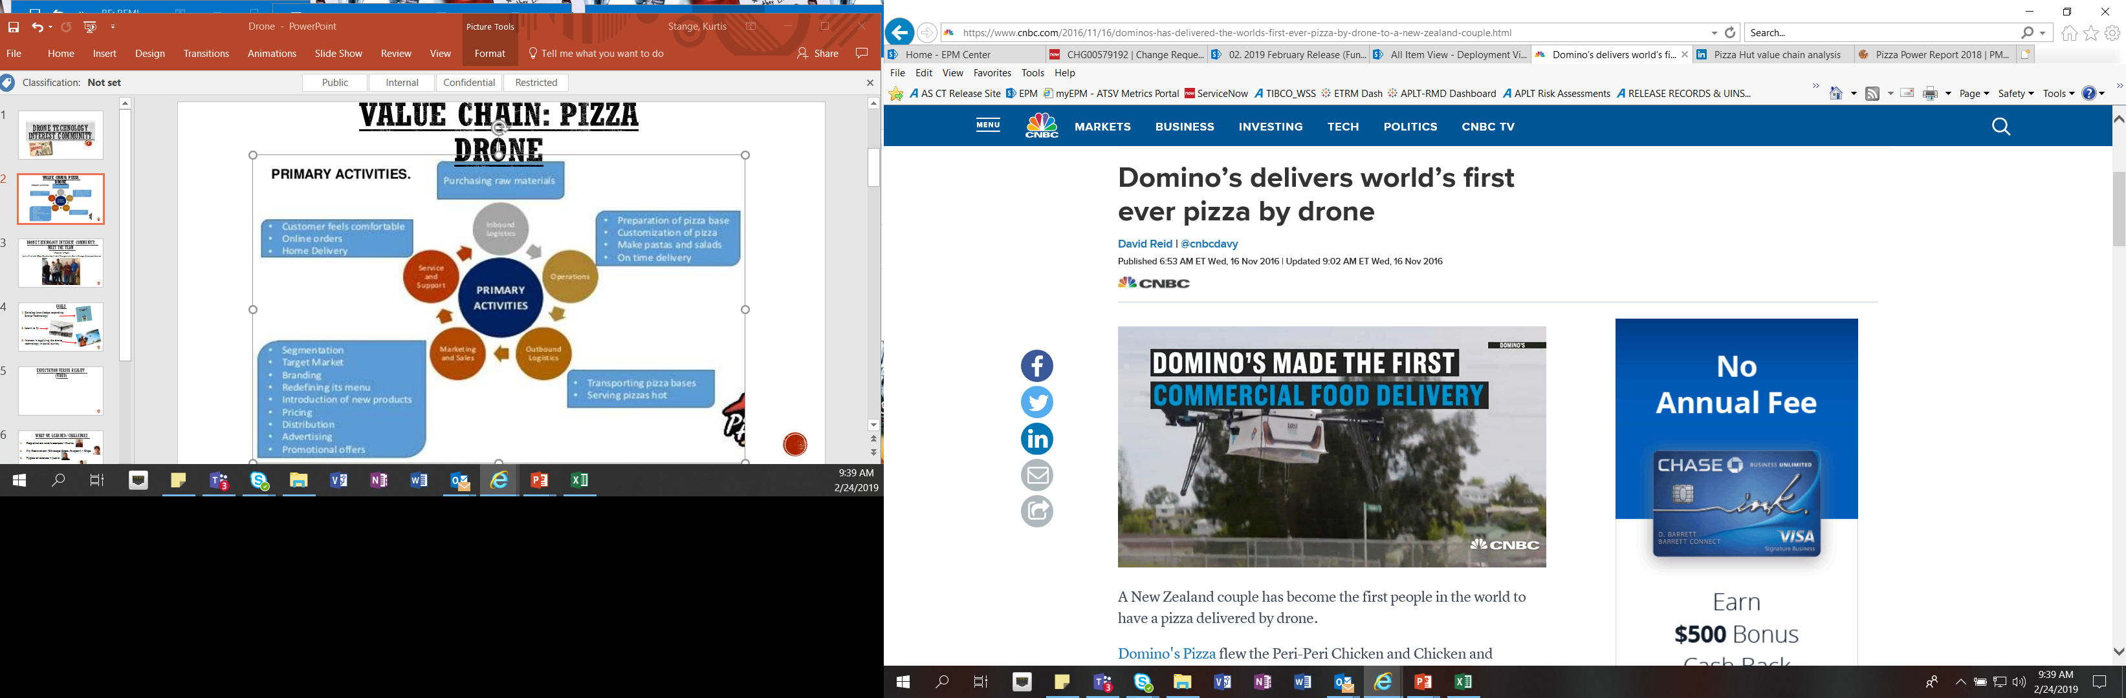
https://www.cnbc.com/2016/11/16/dominos-has-delivered-the-worlds-first-ever-pizza-by-drone-to-a-new-zealand-couple.html

Slide 5
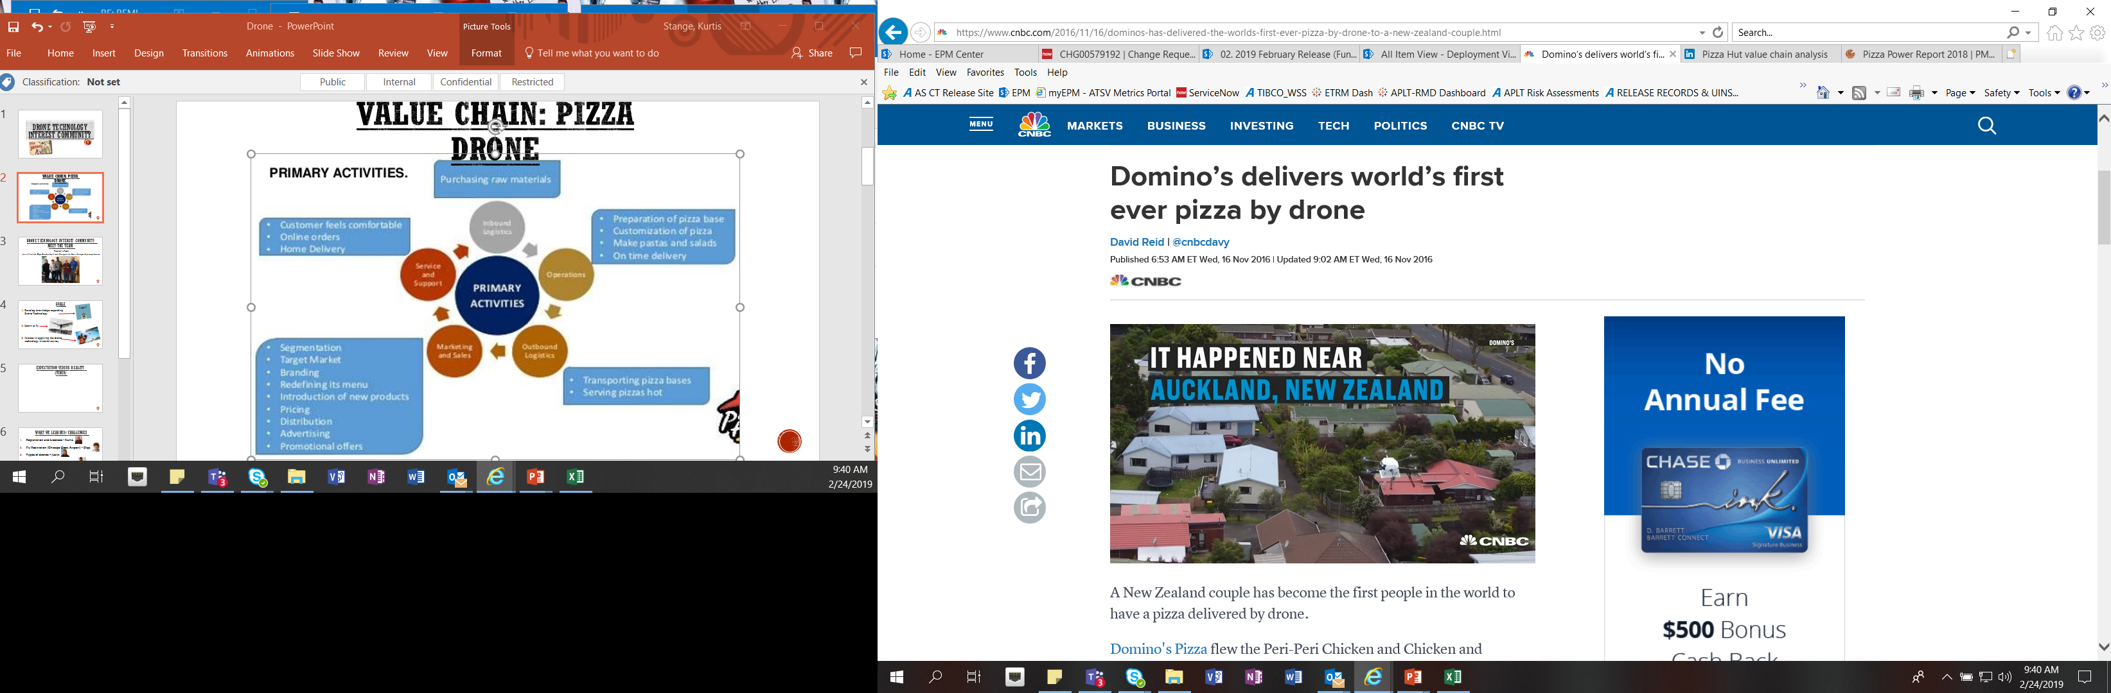
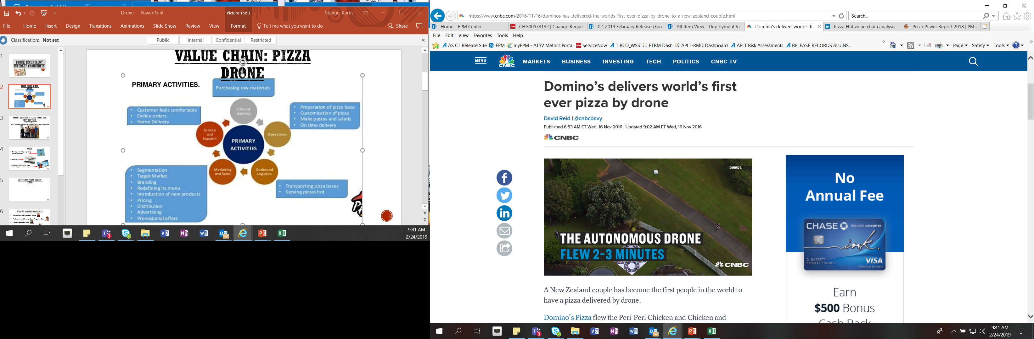
https://www.cnbc.com/2016/11/16/dominos-has-delivered-the-worlds-first-ever-pizza-by-drone-to-a-new-zealand-couple.html

Slide 6
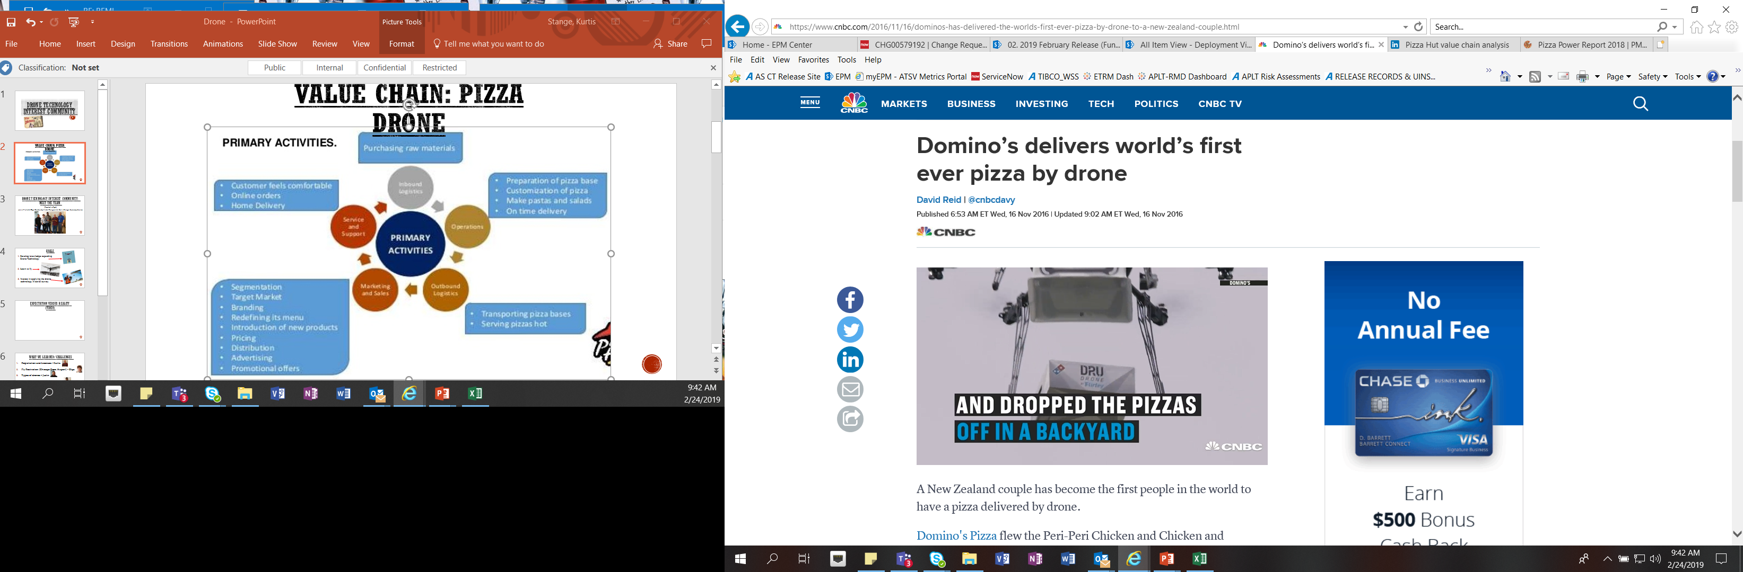
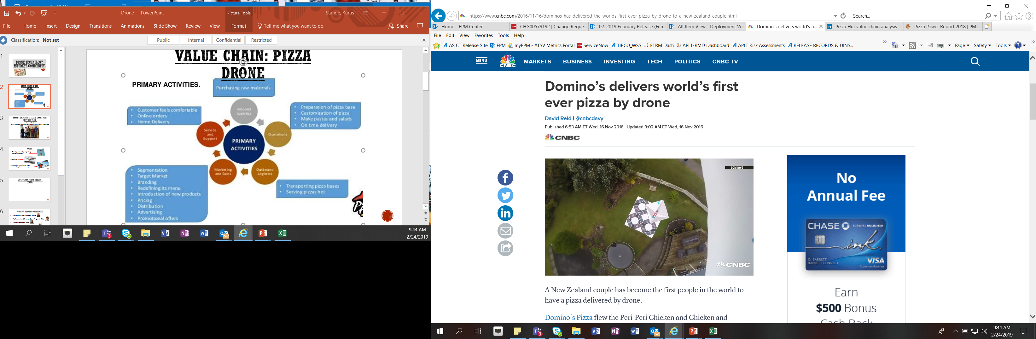
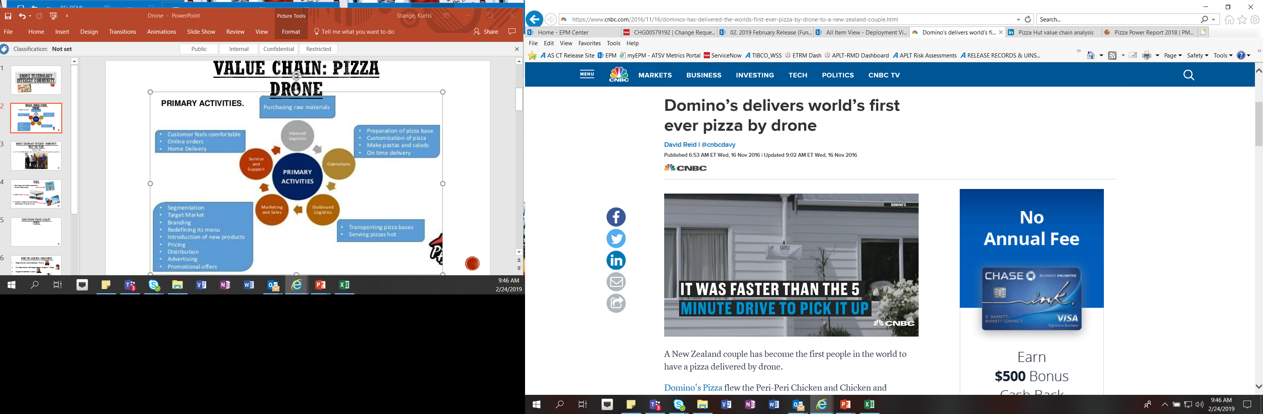
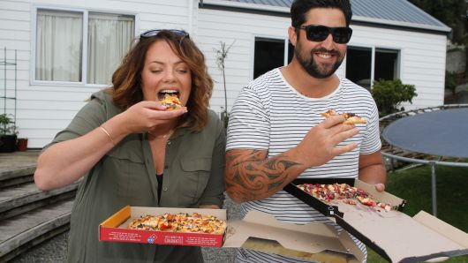
https://www.cnbc.com/2016/11/16/dominos-has-delivered-the-worlds-first-ever-pizza-by-drone-to-a-new-zealand-couple.html

Slide 7
The Dominance of Domino’s
Fast Company named Domino’s one of its Most Innovative Companies of 2017
In part because of its zero-click ordering app that, when opened, automatically sends in the customer’s preloaded preferred order after a 10-second countdown, not to mention its cloud-based AnyWare app that lets users order from their Samsung Smart TV, PlayStation 4, Amazon Echo and even their car (using Ford’s Sync service).
All in all, Domino’s offers at least 10 ways to order pizza online, including tweeting a pizza emoji via Twitter or opening a chat on Facebook Messenger.
But Domino’s isn’t just leading the way in ordering innovations.
The company has also partnered with Ford to test autonomous delivery vehicles. A specially designed Ford Fusion sedan, which Domino’s has tried out with randomly selected customers in Ann Arbor, Michigan, boasts self-driving technology as well as an actual oven.
To get their pizzas, customers must meet the car outside their homes and enter a number on the car’s automated keypad—it’s a delivery without any human interaction. And that’s the real test, company president Russell Weiner has said. “How will customers react to coming outside to get their food? We need to make sure the interface is clear and simple.”

Slide 8
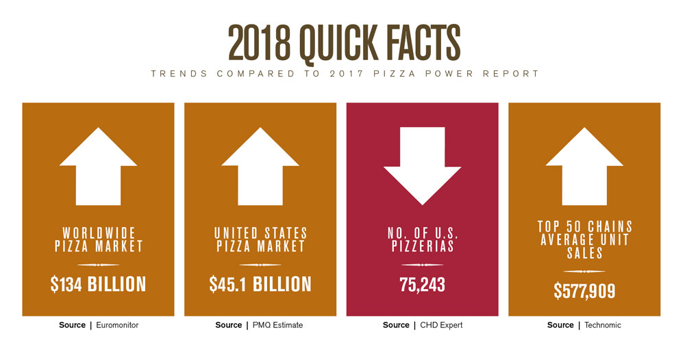
Market Research On Drone Pizza
Focusing on Consumer Needs
The big winners in the pizza race this past year were those who embraced websites, social media, online ordering and delivery technology.
Many of the fastest-growing pizzerias also had the highest web rankings, illustrating that there’s a direct correlation between a strong web presence and healthy sales.
On top of that, consumers are now spending as much money eating out as they do eating at home.
According to a recent study in Consumer Reports, around half of every food dollar is spent at restaurants, equaling roughly $2,222 per person, per year.
http://www.pmq.com/December-2017/The-2018-Pizza-Power-Report-A-State-of-the-Industry-Analysis/

Slide 9
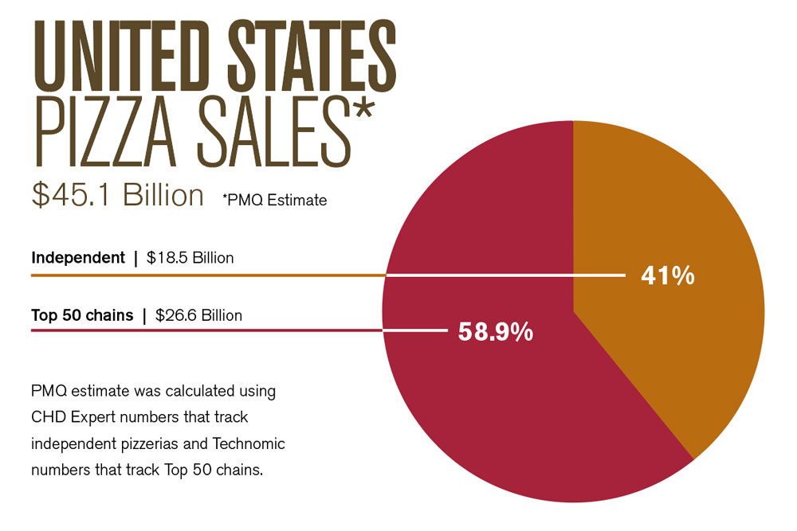
Market Research On Drone Pizza
http://www.pmq.com/December-2017/The-2018-Pizza-Power-Report-A-State-of-the-Industry-Analysis/

Slide 10
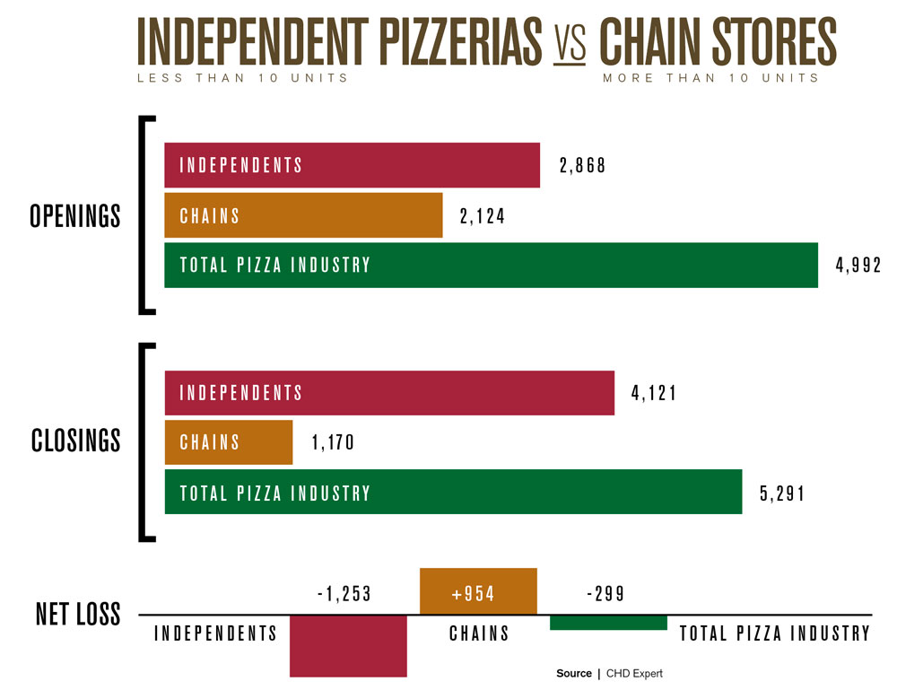
http://www.pmq.com/December-2017/The-2018-Pizza-Power-Report-A-State-of-the-Industry-Analysis/

Slide 11
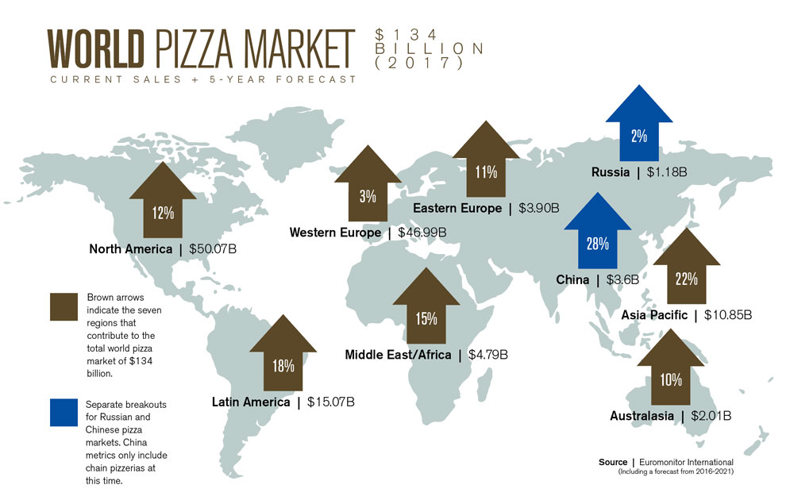
http://www.pmq.com/December-2017/The-2018-Pizza-Power-Report-A-State-of-the-Industry-Analysis/

Slide 12
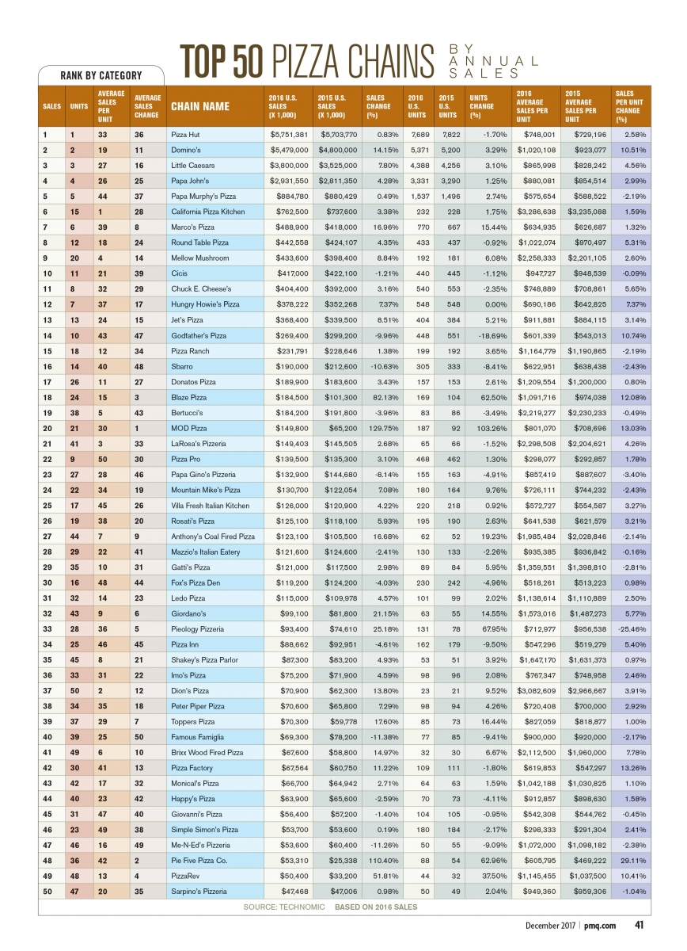

Slide 13
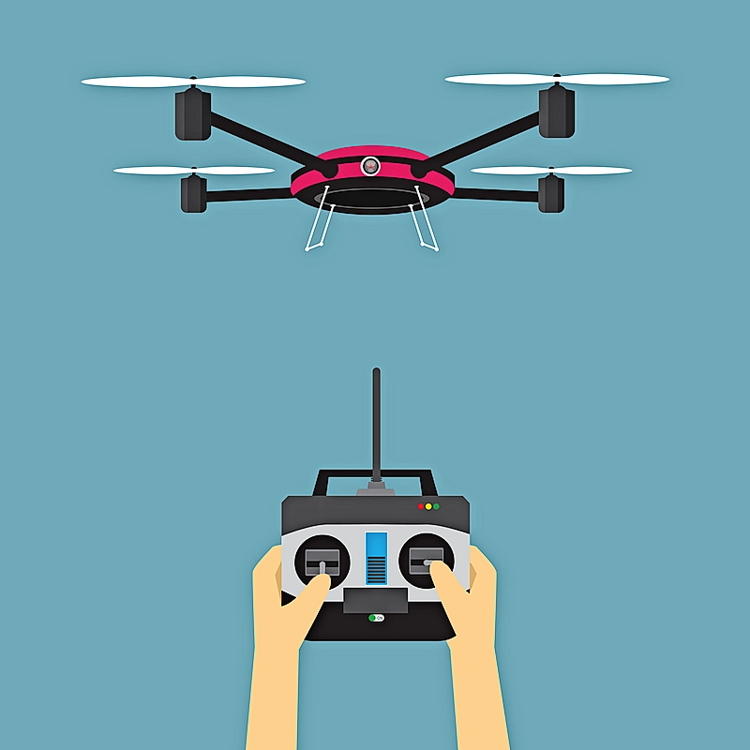
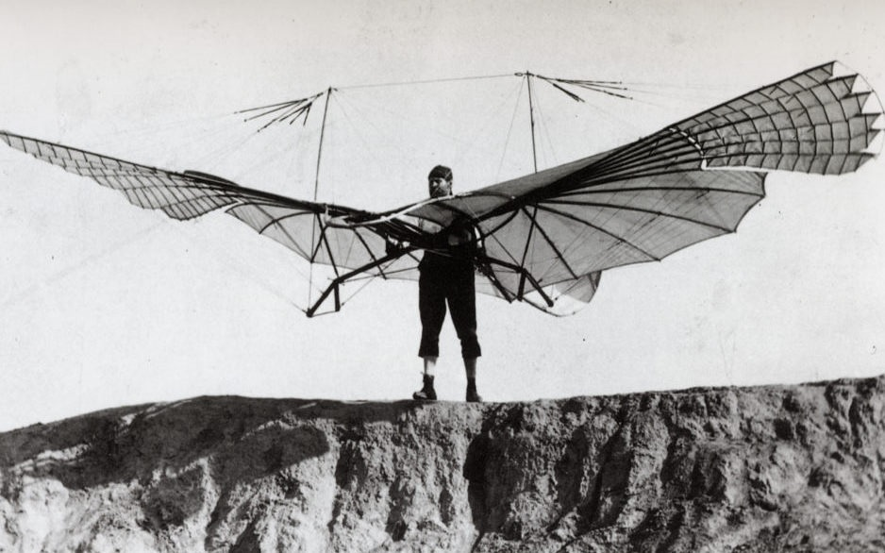
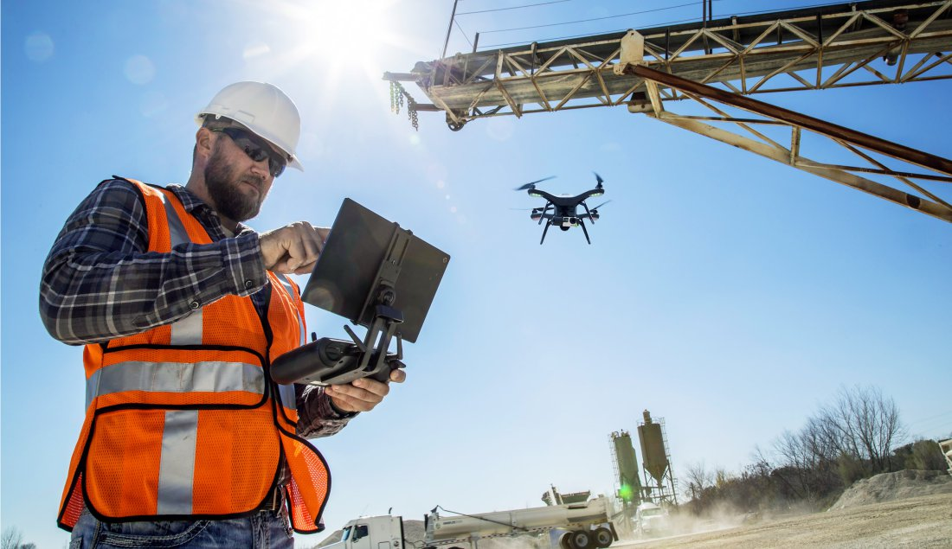
Goals
Develop knowledge regarding Drone Technology
Learn to fly
Interest in applying the drone technology in Pizza Delivery

Slide 14
References
Federal Aviation Administration (FAA) - Drone Regulations & Policies:
https://www.faa.gov/uas/
http://www.businessinsider.com/drones-law-faa-regulations-2017-7
https://www.digitaltrends.com/cool-tech/drone-pilot-faa-regulations-guide/
What to Know Before You Fly: http://knowbeforeyoufly.org/
Air Map Rules: https://www.airmap.com/rules-to-fly-recreational-drones/
Drone Advantage: http://www.tdworld.com/transmission/drone-advantage
The Pros/Cons of Drones: http://www.philforhumanity.com/Drones.html

